Slide 1
Breaking the Silence
THE TRUTH IS LIKE A LION
YOU DON’T HAVE TO DEFEND IT
LET IT LOOSE
IT WILL DEFEND ITSELF
Attributed to St Augustine

Slide 2
Breaking the Silence
Open Public Meeting Rules
Respect the Audience
Mobiles off please
No recording
Q&A; Submit written Questions
Keep Questions on Meeting Topic only

Slide 3
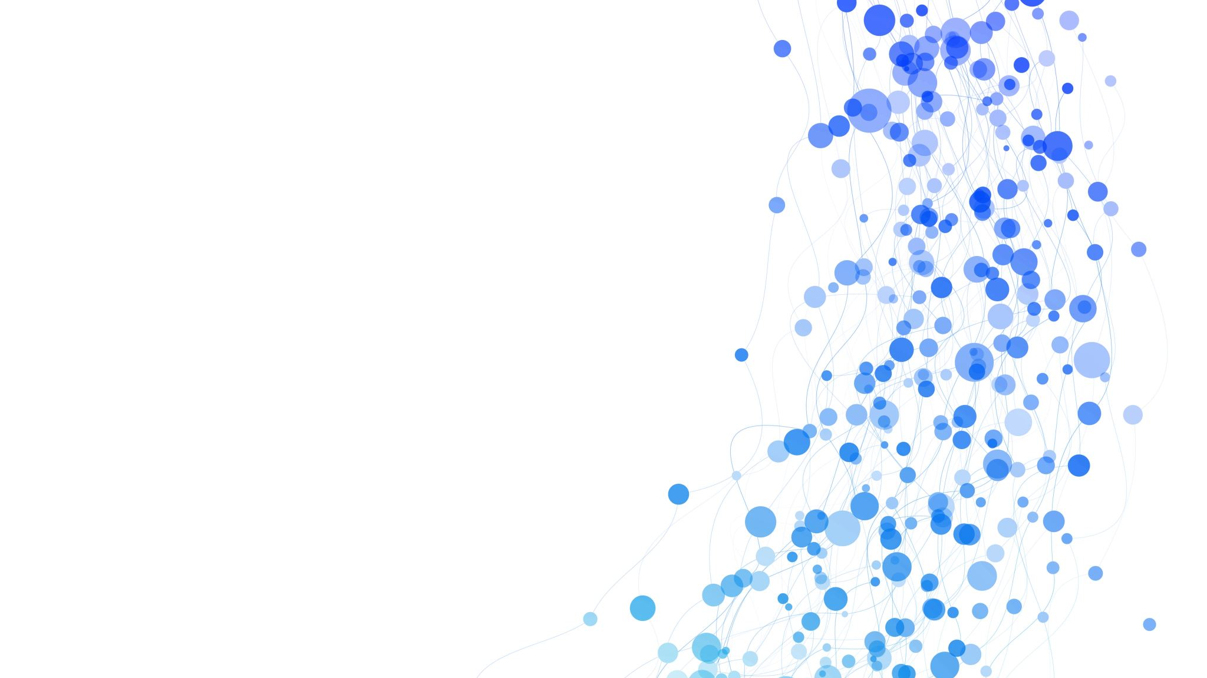
Eisenhower’s Warning 1961
In the councils of government, we must guard against the acquisition of unwarranted influence, whether sought or unsought, by the military-industrial complex. The potential for the disastrous rise of misplaced power exists and will persist. We must never let the weight of this combination endanger our liberties or democratic processes. We should take nothing for granted. Only an alert and knowledgeable citizenry can compel the proper meshing of the huge industrial and military machinery of defence with our peaceful methods and goals, so that security and liberty may prosper together

Slide 4
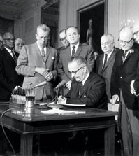
Critical Thinker to Conspiracy Theorist, the CIA Switcheroo
CIA Dispatch 1035-960 targets critics of the Warren Commission;
Accuse theorist of self-infatuation, political motivation, profit making
Attack through sources friendly to CIA
Say it is ‘old news’, irresponsible to speculate, eyewitnesses unreliable
Claim impossible for big plots to be kept quiet
LBJ Getting the Warren Commission Report Sept 24th 1964.
Ref FOI NYT 1976 and referenced in Conspiracy Theory In America by Lance DeHaven-Smith 2013

Slide 5
What is the Origin of Globalism?

Slide 7
Who Runs the West?
An old ideology, rooted in Aristocratic mindsets.
Grounded in economic and financial Imperialism based on Trade Interdependency
Escape hatch of land-based British Empire to this ‘Soft’ Empire was at League of Nations origination
Council for Foreign Relations & Royal Institute of Foreign Affairs is a major conduit
Seduction is to become part of the Globalist class, subvert nation state democracies & constitutions
Steps are Free Interdependent Trade Agreement, Regional Unions then Global Union
Delivery is United Nations, WHO et al
Risk of viewing the masses as serfs, to be plundered & downsized to serve the agenda

Slide 8
The Global Public Private Partnership
Bank for International Settlements (B.I.S)
Central Banks (Coordinated by B.I.S)
They ultimately control the money supply and thus global markets, trade and national economies
They already directly fund government spending. Monetary policy has become fiscal policy, Digital Currency up next
Policy Makers
‘Think Tanks’ & Global Representative Groups
These formulate the policies to achieve GPPP objectives. Resource allocation determined by the B.I.S and Central Banks but they work in ‘partnership’ with the think tank and the representative bodies to convert that into global political policy.
Policy Distributors
These organizations and bodies take policy objectives from the policy makers and distribute them to the policy enforcers.
Philanthropists
Global Corp’s
N.G.O
Policy Enforcers
The Policy Enforces exploit or work with the Selected Scientific Authorities to justify the policies they are required to enforce.
National Governments
Selected Scientific Authorities
Civil Service, NHS, RRU, IPSO, Ofcom, Police, Military, Courts, Local Governments, Statutory Agencies etc.
SAGE, NERVTAG, ICL, MHRA, JCVI, etc.
Policy Propagandists
The propagandists and hybrid warfare specialists are tasked with convincing the public to accept and hopefully believe in the politics. They use psychological manipulation, disinformation, misinformation censorship and propaganda
Propagandists and Hybrid Warfare Specialists
M.S.M, Fact Checkers (PolitiFact, Full Fact etc.) Social Media Platforms, Hybrid Warriors (77ᵗʰ Brigade, @Huteighteen etc.) Anti-Hate Campaigners (CCDH etc.)
Policy Subjects
The Public
We are subjects of the policy which cascades down through the GPPP system. We largely pay for the system through taxation and public borrowing. The system is designed to exploit us, but we are an increasingly unnecessary component as the GPPP look to seize the global commons.

Slide 9
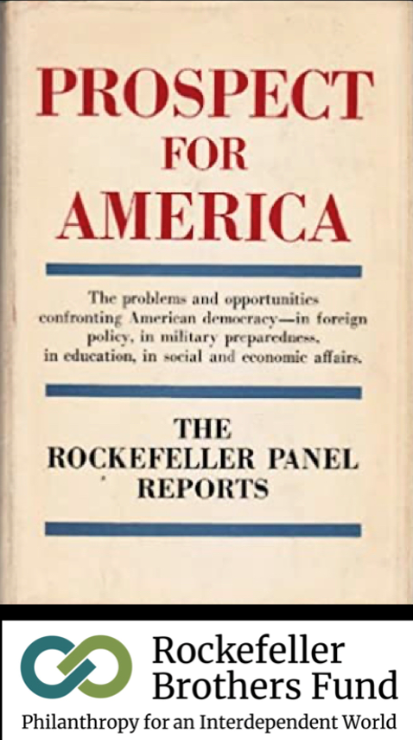
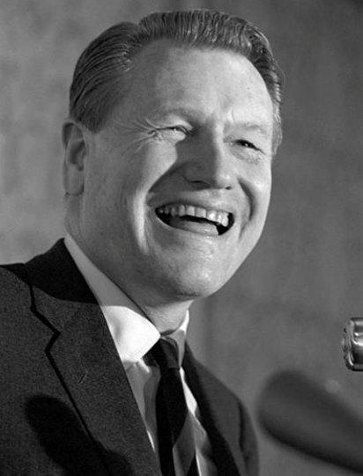
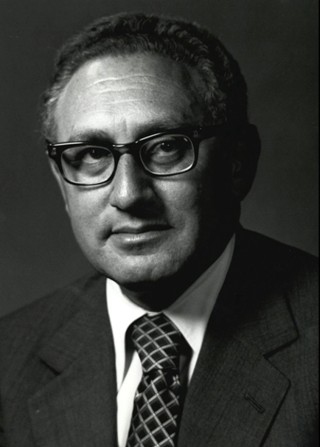
Their Challenge: “To build a New Structure, which will make possible the fulfilment of…
Nelson
Rockefeller
Henry Kissinger
…the basic purposes of humanity.”
ROCKEFELLER SPECIAL STUDIES PROJECT (1956 – 1961)

Slide 10
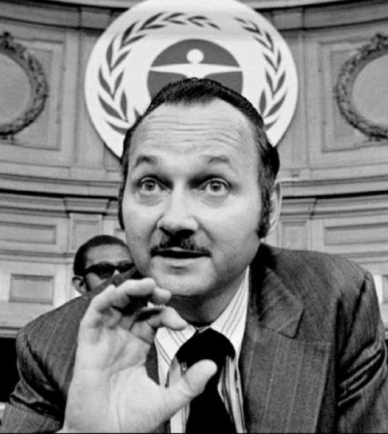
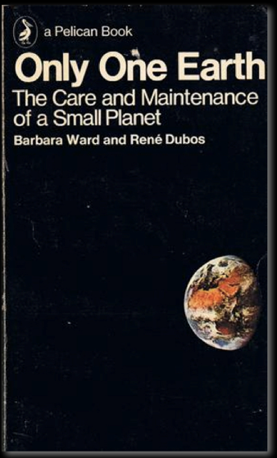
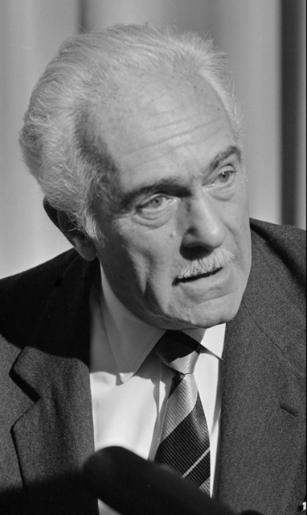
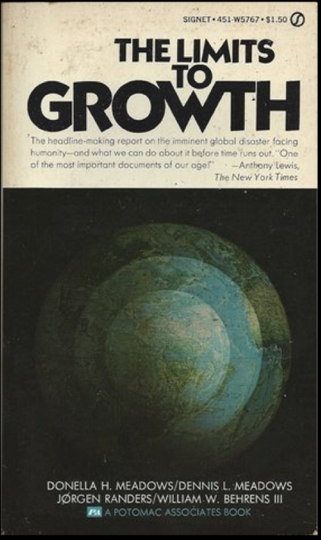
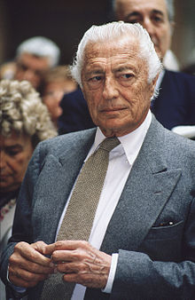
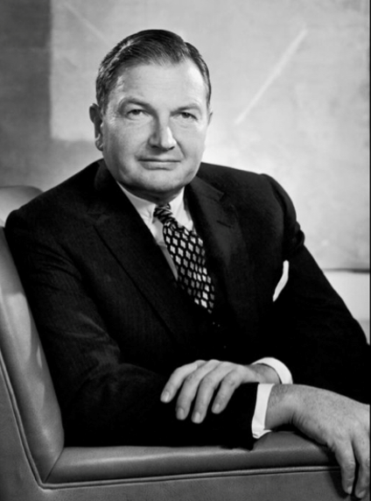
Global
Management
Required!
Maurice
Strong
Aurelio
Peccei
Giovanni
Agnelli
Stockholm Conference
(UN 1972)
“WORLD PROBLÉMATIQUE”
David
Rockefeller

Slide 11
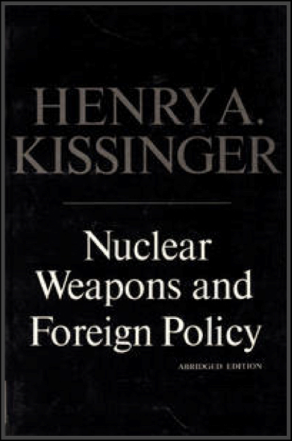
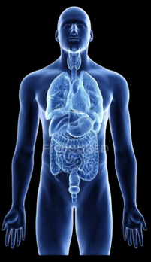
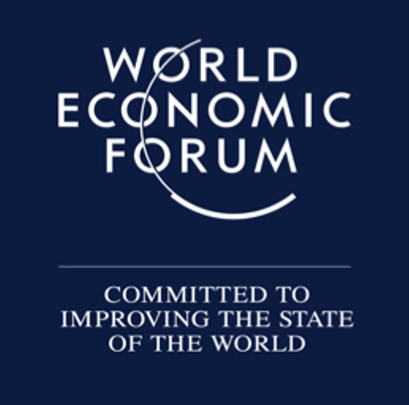
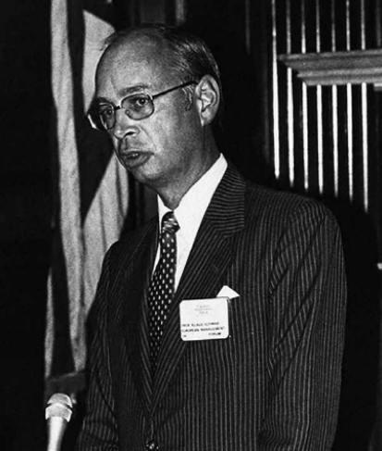
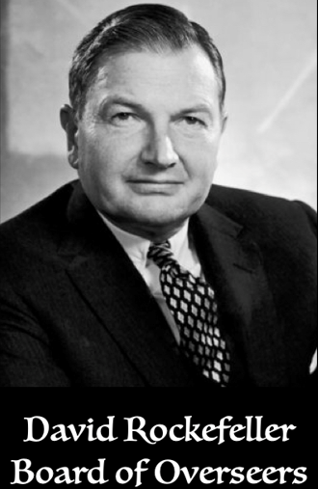
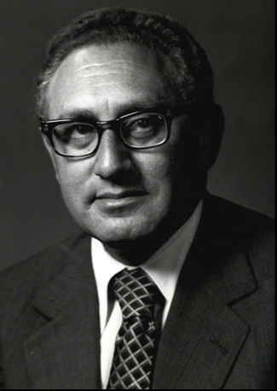
Nelson
Rockefeller
David
Rockefeller
They Identified ‘Climate Change’ - back in the 1950’s
…as an opportunity
Henry Kissinger
ROCKEFELLER SPECIAL STUDIES PROJECT (1956 – 1961)
Council for Foreign
Relations (Chair 1970-1985)
GLOBAL CHALLENGES
1971
Henry Kissinger
Klaus
Schwab
“The Apprentice” (1967)
Harvard’s International Seminar

Slide 13
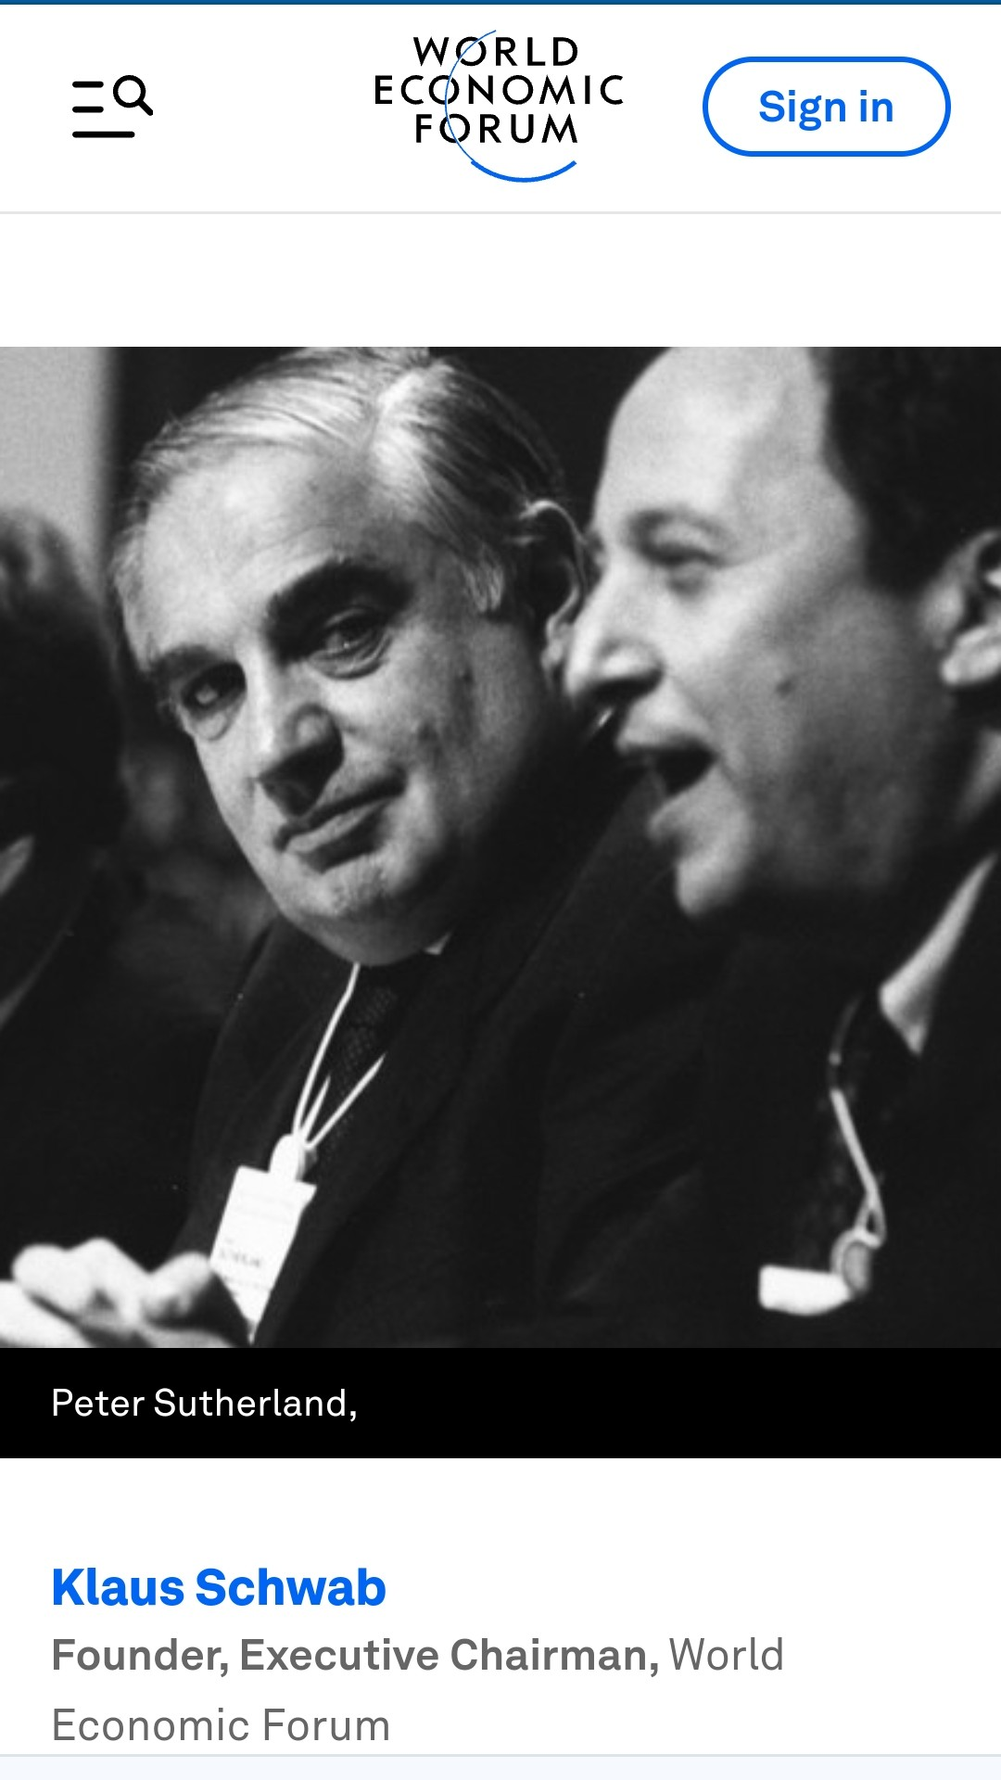
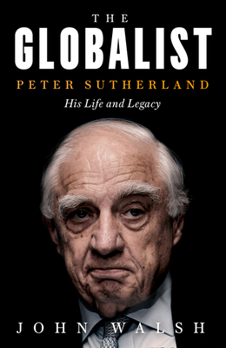
Jan 8, 2108 Eulogy by Klaus Schwab, Founder, Executive Chairman, World Economic Forum
“WEF lost a Great Friend, absolutely essential to the Forum building global impact. First political leader I met who really understood multistakeholder cooperation. Long time annual meeting participant over 30 years. Board of Trustees 1995-2013. Peter was a mentor of mine. I owe him for a substantial proportion of our relevance in global affairs. He will always be held in our highest esteem at the World Economic Forum”

Slide 14
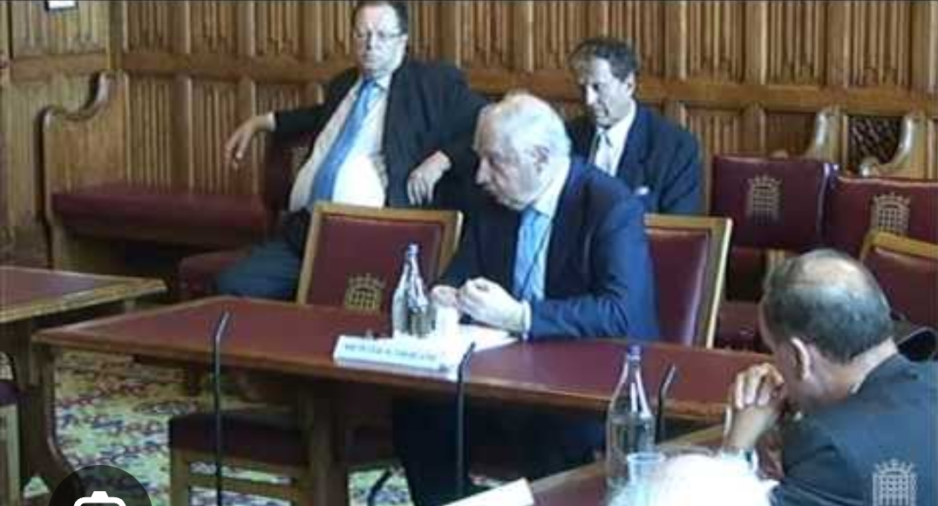
EU should ‘Undermine National Homogeneity’ says UN Migration Chief Peter Sutherland
BBC Report 21 June 2012 on Peter Sutherland Chairman Goldman Sachs, address to House of Lords committee on migration.
Migration was ‘a crucial dynamic for economic growth’ in some EU nations.
Criticised EU states targeting ‘highly skilled’ argued ‘at the basic level individuals should have a freedom of choice’ about whether to come and study or work in another country’

Slide 15
WEF Heaps Praise on Irish Citizens Assembly on Eve the Pandemic, 29th Dec 2019
Key Pillar in Stakeholder Capitalism
Replacement of Representative Democracy
Network of NGOs, Unions, Institutions, Govt Agencies working with Corporations
No controls against infiltration and captivity?

Slide 16
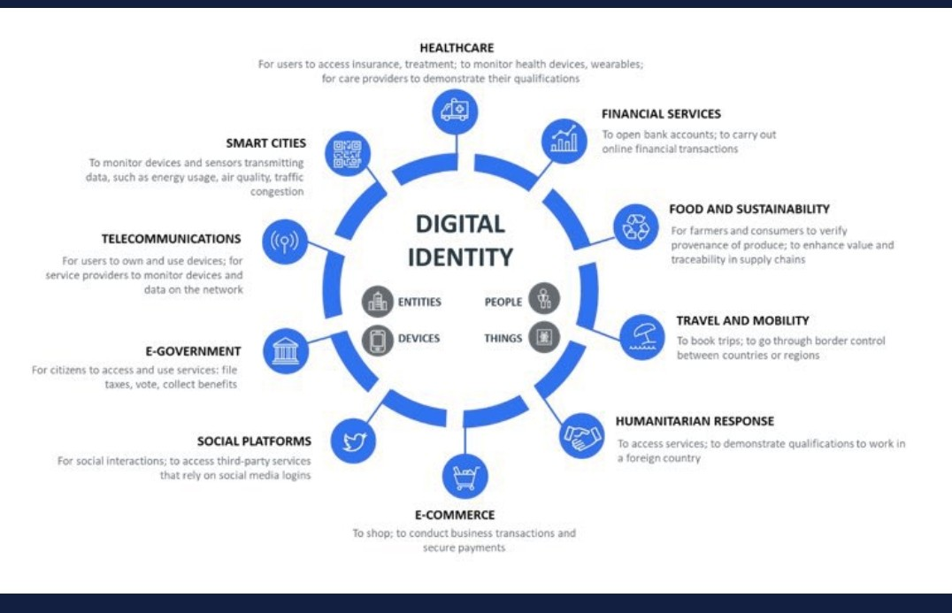
The Snare is Central Bank Currency? The Event to Trigger likely to follow the Playbook?
The Trap

Slide 17
Central Bank Digital Currency By Its Masters

Slide 18
Two Quadrillion in Derivatives
Total Global Assets c.$500 trillion
Total Global GDP c.$100 trillion
Derivatives 2030 est c.$6,000 trillion
Money Growth Faster than GDP Growth
All pooled securities are collateral?
Never attempt to win by force what can be won by deception. Niccolo Machiavelli

Slide 19
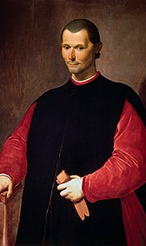
Never attempt to win by force what can be won by deception. Niccolo Machiavelli
1994 US Uniform Commercial Code is quietly altered without Act of Congress
Ownership of Property replaced with Contractual Rights
2004 EU forms Legal Certainty Group
The Exchange of Letters with FED and EU lawyers 2006 is the Smoking Gun
2006 global treaty mimics USA in Hague Convention
2014 Central Securities Depository Regulation (CSDR) is completed by EU Directive copying the US model
Thinly capitalized Central Clearing Parties the weakest link at the fulcrum of the system
Insolvency legally allows liquidators to seize and control all assets segregated or not as the collateral supporting two Quadrillion of derivative contracts

Slide 20
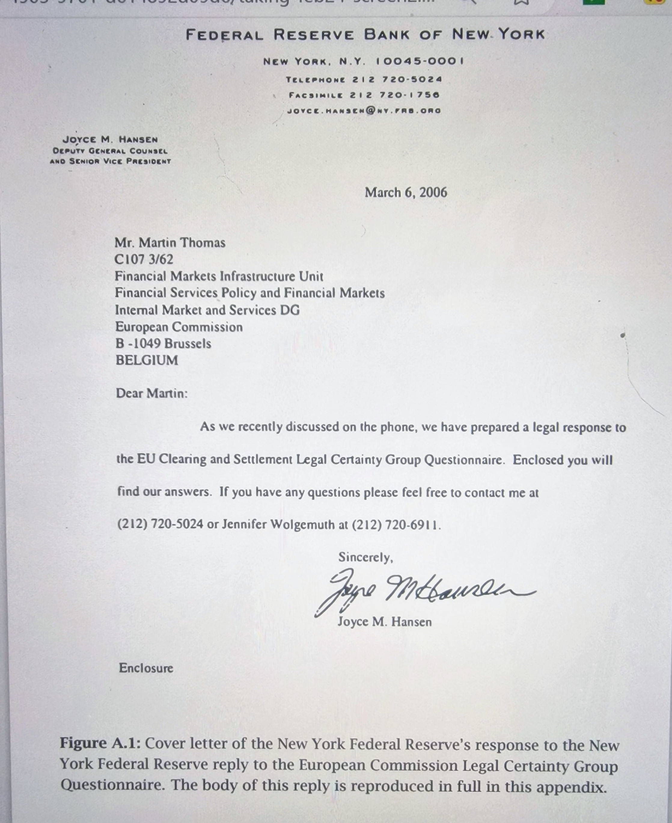

Slide 21
The Smoking Gun?
March 2006 the European Commission Legal Certainty Group gets a fulsome response from Federal Reserve Bank of New York
The full reply to the extensive Q & A is in The Great Taking by David Webb
It is not opinion, but fact unearthed after deep dive into EU internals
It is why the reality of Hyper-Hypothecation aka collaterisation, is gathering amazement
Action must follow including in EU

Slide 22
Tennessee Senate Fight
Examined the David Webb evidence
Prepared Bill to prioritise Entitlement holders
Faced Banking lobby threat of State isolation
Game on versus Fed and BIS as news spreads
Unanimous vote in favour, no bi-partisanship

Slide 24
The Psychology of Totalitarianism by Mattias Desmet
Grounded in lifelong studies by Hanah Arendt includes the banality of evil, Eichmann in Jerusalem 1963
Two pillars, utopian vision coupled to overwhelming fear so personal freedom is sacrificed for safety
Human murmuration and abdication of individualism
Surveillance society well underway before C19, foundation to Western style Social Credit System
Tyranny of micro rules to reduce feelings of anxiety from taking risk
Proclivity to surrender critical thinking and identify with cancel culture mobs on social media.
20 public executions Tsarist Russia. Post Revolution 540 rising to 12,000 to 1937, 600,000 afterwards
“The moment Arendt had anticipated in 1951 seems to be rapidly approaching; the emergence of a new totalitarian system led not by ‘ringleaders’ like Stalin or Hitler but by dull bureaucrats and technocrats”

Slide 25
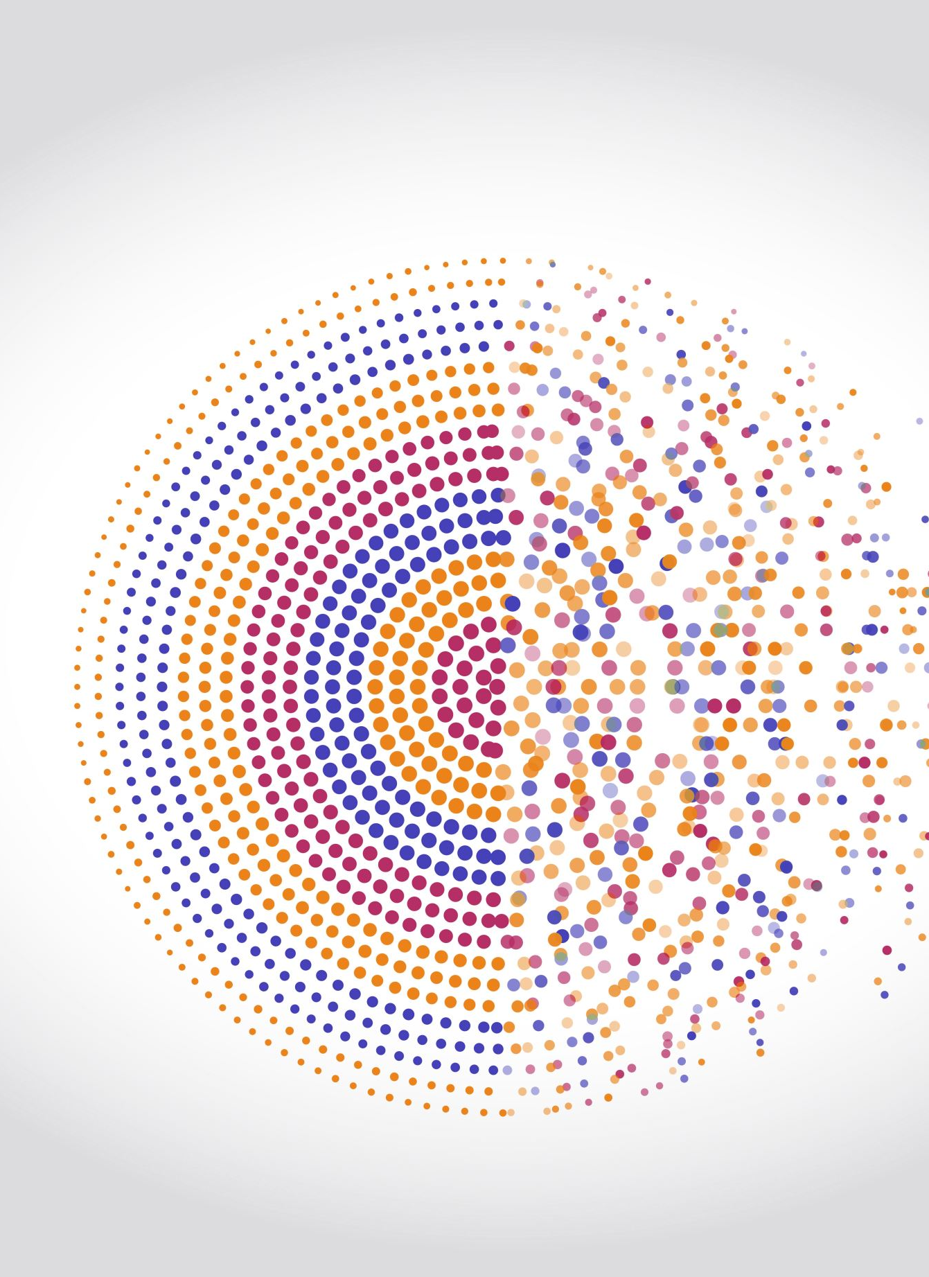
Four Conditions for Mass Formation
1. Generalised loneliness and isolation. No one answers the phone anymore.
2. Feeling of meaninglessness and disengagement, sleepwalking through life
3. Elevated levels of Free-Floating Anxiety, an anxiety without an apparent object
4. Free-Floating Frustration, Irritability and Unvented Anger
For Mass Formation about 1/4 of public feel this way, thus vulnerable to turn their anger on fake culprits; Kulaks, Jews, the Virus Unvaxxed
Facts and Counter Science becomes irrelevant, it is about showing zealous compliance to the new regime.
The middle 40% to 60% go along but keep the head down, compromised or fearful.
Up to 20% see through it, becoming the targets, for vilification, ridicule or mass murder per 20th century totalitarianism
Narrowed field of attention, like looking through a keyhole
Totalitarians attack all societal bonds including family.

Slide 26
BioWeapon the Back Story
1347 port city Caffa, Black Sea, now Feodosia Crimea
1763 Fort Pitt, present day Pittsburgh
World War I Trench Warfare
1925 Geneva Protocol
1943 Fort Detrick Maryland US Army Biological Warfare Lab
1961-1971 Vietnam, Agent Orange, highly toxic dioxin
1975 Biological Weapons Convention gives loophole to Gain-of-Function (Dual Purpose)
1990 Gulf War, Anthrax Vaccine to US troops. Gulf War Syndrome

Slide 27
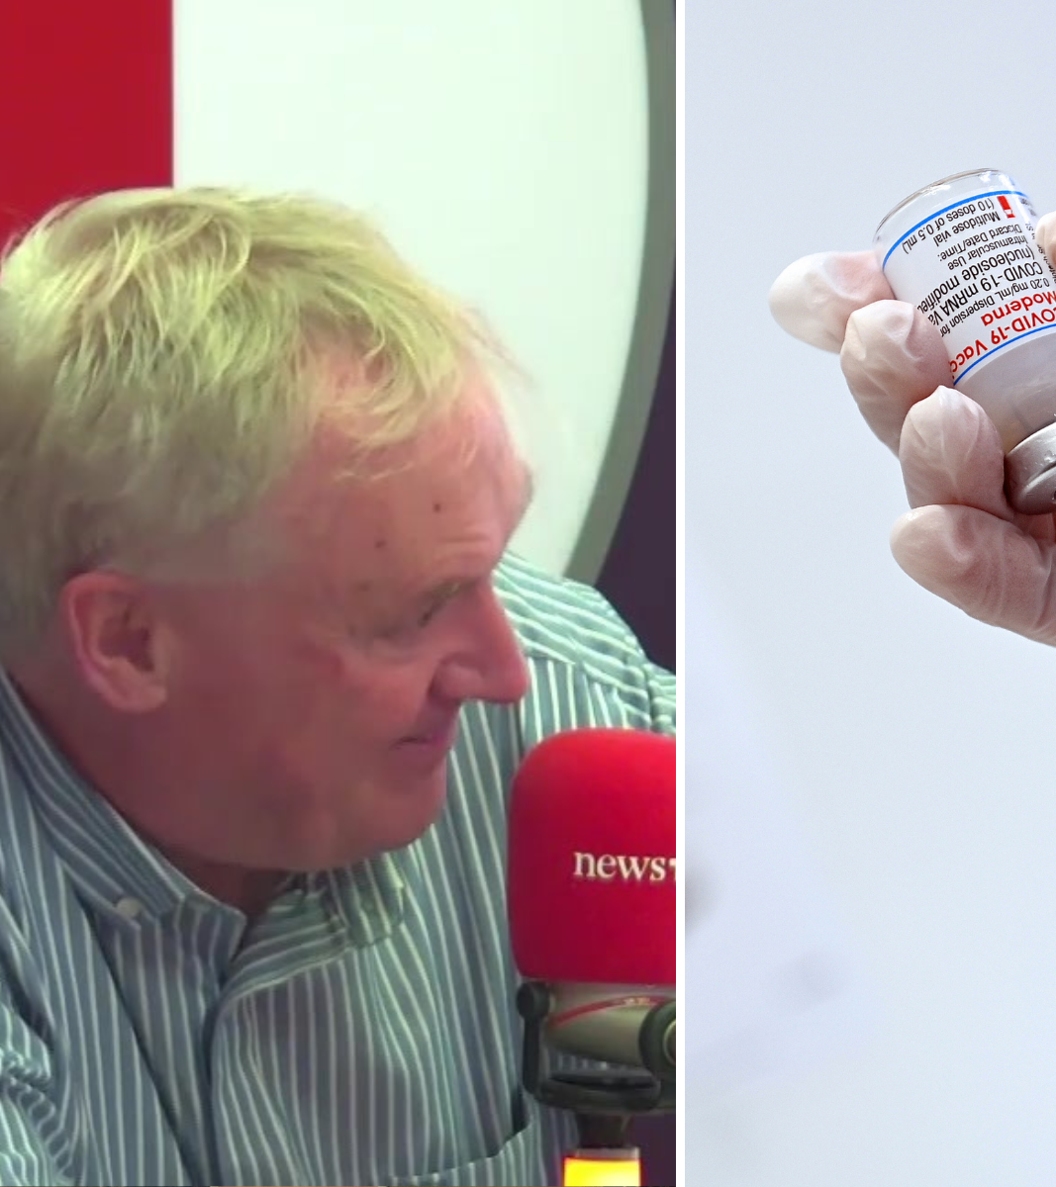
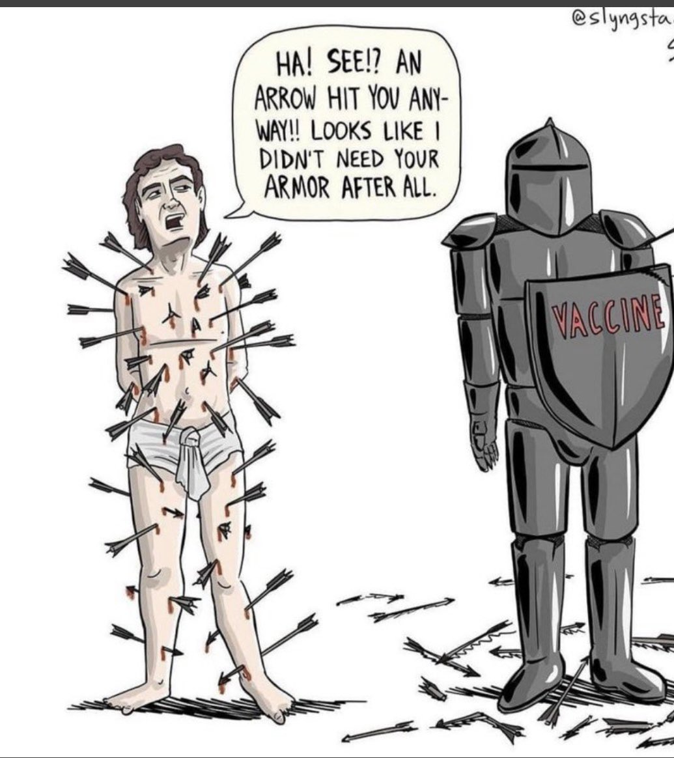
Luke’s Twitter 14.8.21

Slide 28
Propaganda Game Plan the Top Ten
Hype fear, pandemic imminent. Incriminate a pathogen, exaggerate infection rate, warn of mutant strains, stoke hysteria and high anxiety in public
Broadcast big lifestyle changes to protect lives, keep changing to leave public and politicians off balance
Inflate prevalence with bogus amplification of virus and inflate death data
Attack counter science like Great Barrington Declaration, slander dissenters as conspiracy theorists
Trample over informed consent between GPs and patients. There is only ONE solution, TAKE THE JAB
Vilify repurposed drugs like Ivermectin, loading up on Vitamin D, getting fit, losing weight
Focus public money and all resources on uber-profitable new drugs even if dangerous and ineffective
Openly champion Big Pharma and Emergency Use Authorisation to FastTrack LAB to JAB
Cite only experts hiding conflicts of interest that can be relied upon to support the narrative
Speak Out Often, repeating the message over and over

Slide 29
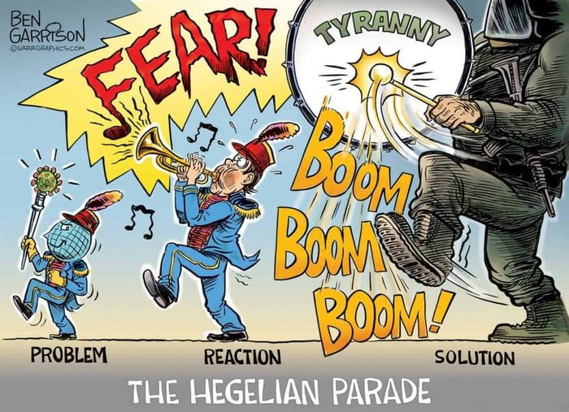

Slide 30
Fauci Fêted April 2024

Slide 31
Gomperz Dynamics
Powerful Seasonality
~80% De Facto Immune
Deaths comparable to Bad Flu
Impact Modelling was Nonsense
Sweden Vs Nordics was Nonsense
Spanish Flu Comparison: Nonsense
Lockdowns highly INEFFECTIVE
Masking highly INEFFECTIVE
“Casedemic” WAS absurd
PCR was highly misleading
A Positive PCR is NOT a real “Case”

Slide 32
The Run Up
NIAID largesse incubates assembly line of drugs for symptoms of disease it monitors, creating marketplace of Drug Investigators clans loyal to manufacturers eg Pfizer, Glaxo, Merck etc
Skimming to Academic Overhead, up to 2/3rds with of grants with per trial patient up to $10,000 each
“Why don’t we be partners”? Gates to Fauci in 40,000 square foot mansion Seattle 20yrs before C19.
NIAID grants to Gain-of-Function research, weaponising pathogens, including to EcoHealth Peter Daszak which flows to Shi Zhengli at the Wuhan Institute of Virology.
Ralph Baric PhD, University North Carolina Chapel Hill gets over $30m for two 5yr studies into genetics of pathogens 2012-2013. Files patent 2015 relating to a chimeric coronavirus spike protein. Total filings 20 patents.
Obama declares a moratorium on gain-of-function 2014 in USA. Baric ignores, co-writes with Shi Zhengli of Wuhan in Nature Medicine 2015 and
2016 ModeRna, now Moderna patents spike proteins for coronaviruses research, six yrs after its founding by Stephanie Bancel who owns 7.3%. Revenues 2023 $7bn.

Slide 33
Covid; Timeline to Lockdown and Captivity
Sep. 2019
first circulates, Chinese Govt raid Wuhan Lab
Sept
Gates Foundation puts $55m into BionTech pre-IPO
Oct
Gates & WEF game Global Coronavirus Pandemic 60m deaths
Nov
Ben Hu Wuhan Institute of Virology is Hospitalised. China Morning Post reports 55yr old Wuhan man with mysterious new virus
30 Dec.
China declares pneumonia outbreak linked to mystery virus, first death 12 days later
11 Jan. 2020
SARS-CoV-2 genetic sequence is released, China denies human-to-human transmission
26 Jan.
Fauci at NIAID describes Wuhan Virus as very very low risk, next day Peter Daszak, EcoHealth confirms NIAID funding went into Wuhan lab to identify how SARS related virus could bind to human cells
30 Jan.
WHO declares a Public Health Emergency of International Concern (PHEIC)
31 Jan.
Trump bans travel from China. Scientists in New Delhi issue paper, spike proteins had unique genetic sequence and are pressured to withdraw.
1 Feb.
Jeremy Farrar hosts secret teleconference involving Fauci after which Fauci admits by email that Chinese scientists working on bat viruses gain of function and possibility of a lab leak.
Feb 19th The Lancet prints Daszak letter backed by 27 associates, silent on conflicts of interest, ridiculing bioweapon leak as conspiracy theory.

Slide 34
Afterwards
Jan 2020 Jeremy Farrar chief of Wellcome Trust stands in for WHO Director General at DAVOS, cheers on China Lockdown policies.
Farrar, a tight doctoral friend to George Gao China Centre for Disease Control and is identified by RFK as involved in leak Cover Up
May 2020 study attacks Hydroxychloroquine, much later it is retracted but not after damage in MSM.
Oct 2020 Fauci NIAID and Collins NIH coordinate trashing the Great Barrington Declaration against Lockdowns, revealed a year later under FOI by American Institute for Economic Research
August 2021 Ivermectin openly attacked by FDA ‘You are not a horse’ as Pfizer vaccine is US authorised.
Founded by Gates, CEPI (Coalition for Epidemic Preparedness Innovations) is led by Richard Hatchett from 2017.
Hatchett in 2005-2006 Bush Govt advocated for militarised authoritarian policy, imposing Lockdowns, masks and social distancing, escaped only by taking emergency developed jabs with indemnity to Pharma
Hatchett leads CEPI press conference with Farrar at Davos Jan 2020 as WHO abandons anti-lockdown policy in favour of Hatchett’s Lockdown & Jab.
Farrar becomes Chief Scientist WHO in 2023

Slide 35
WHO Public-Private Partnership Benefits
No Morals or Ethics required
Infallible Risk-Free Model
Fully Indemnified Business, No Courts
Guaranteed by Governments
Plunder Taxpayers through Deficit Borrowing
Create Global Demand by Mass Anxieties but no advertising required
Totally Reliant & Captive Regulation, will deliver your marketing punch
Power to confine people in their homes until they submit to you
Wash Rinse Repeat
Work with Nation States to weaponise the next one

Slide 36
‘Fascism should more appropriately be called Corporatism because it is a merger of state and corporate power’ Benito Mussolini

Slide 37
Totalitarianism in Five Questions
Self-authorisation by mere declaration of pandemic?
No Checks & Balances?
Open-ended immunity from criminal prosecution?
Crush Informed Consent and Certify Global Emergency Use Drugs?
Psychological control by censorship and propaganda?
Find the space for Human Rights & Dignity

Slide 38
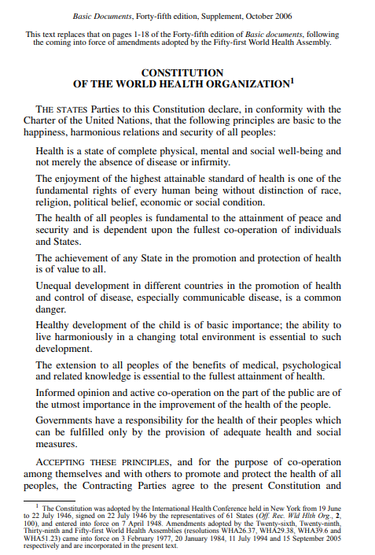
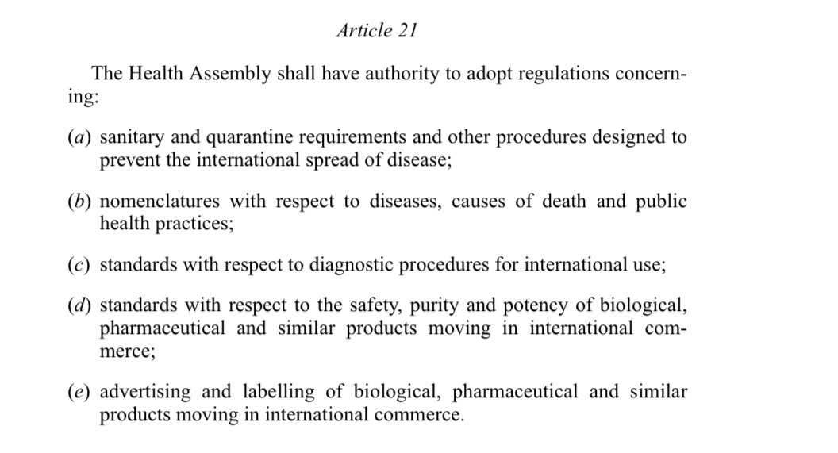
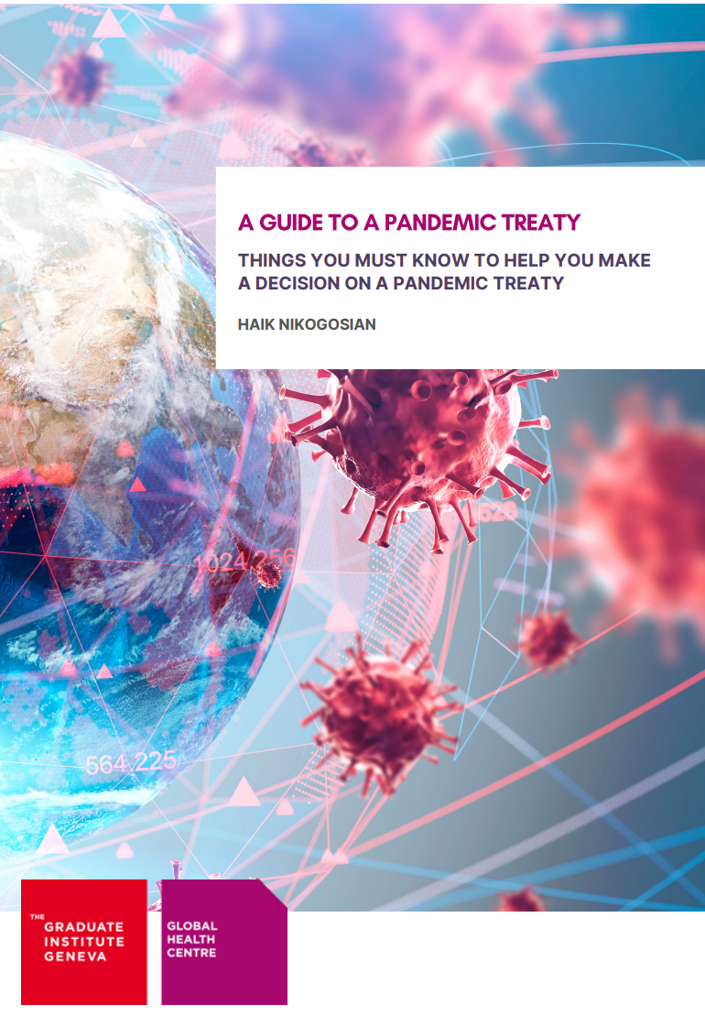
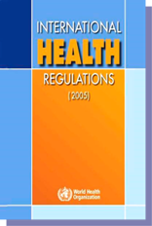
The WHO 2-track process to ‘Health Security’ Monopoly
A
A new “Treaty”, Convention or international instrument procedure is adopted on 1 December 2021
B
Major amendments to the 2005 IHR to be adopted at the World Health Assembly
In May 2023 or 2024
Legal framework of A + B
Creates new supranational body that governs the world and puts WHO in charge of PHEICs
source: www.apps.who.int
[retrieved 20 May 2022]

Slide 39
Dangerous Ambition
Working Drafts on IHR and the Pandemic Agreement cause alarm
Final Drafts for 76th World Health Assembly May 27th may differ a little, due to push back
WHO to be global vaccine & prophylaxis authority via certificates Annex 6 para 3 IHR

Slide 40
WHA 27th May Deadline; Pandemic Agreement + International Health Regulations
WHO is in breach of its four-month window for IHR changes Article 55 (2) IHR
DG has emphatic authority to declare PHEICs or Pandemic Emergencies Art 49 (5) IHR
PCR in waste water 24 hour cycle in multisectoral surveillance links to Global Genomic Surveillance Reports and supplies to a WHO platform Annex 1 pg45 IHR
Members set up Pathogen Labs, Gain-of-Function is not excluded Art 12 PA
Report to centralized platform called PABS Art 12 PA

Slide 41
WHO Ambition?
December 2021, WHO tabled an international treaty on Pandemic Preparedness and Response.
In December 2022 WHO, gets largest private donation from the Gates Foundation (BMGF), announces the appointment of its new Chief Scientist Jeremy Farrar.
Has been in ‘secret’ talks to mid April 2024 . Must be read in conjunction. Papers at 1215Tribes.com
One Health, had powers over Human, Animal, Plant, and Ecosystems Article 1(b) PA
Clampdown on counter science aka Disinformation Misinformation in past drafts, a deflection
Establishes Public-Private pathogen master library sees pathogens as national assets for Gain-of-function enhancement and allied to patented vaccines.
Open-ended supply line of PHEICs a real risk; engineer the pathogen, create panic, sell antidote.

Slide 42
We cannot comply our way out of tyranny.
We must withdraw our Permission
We must create our way out of tyranny.

Slide 43
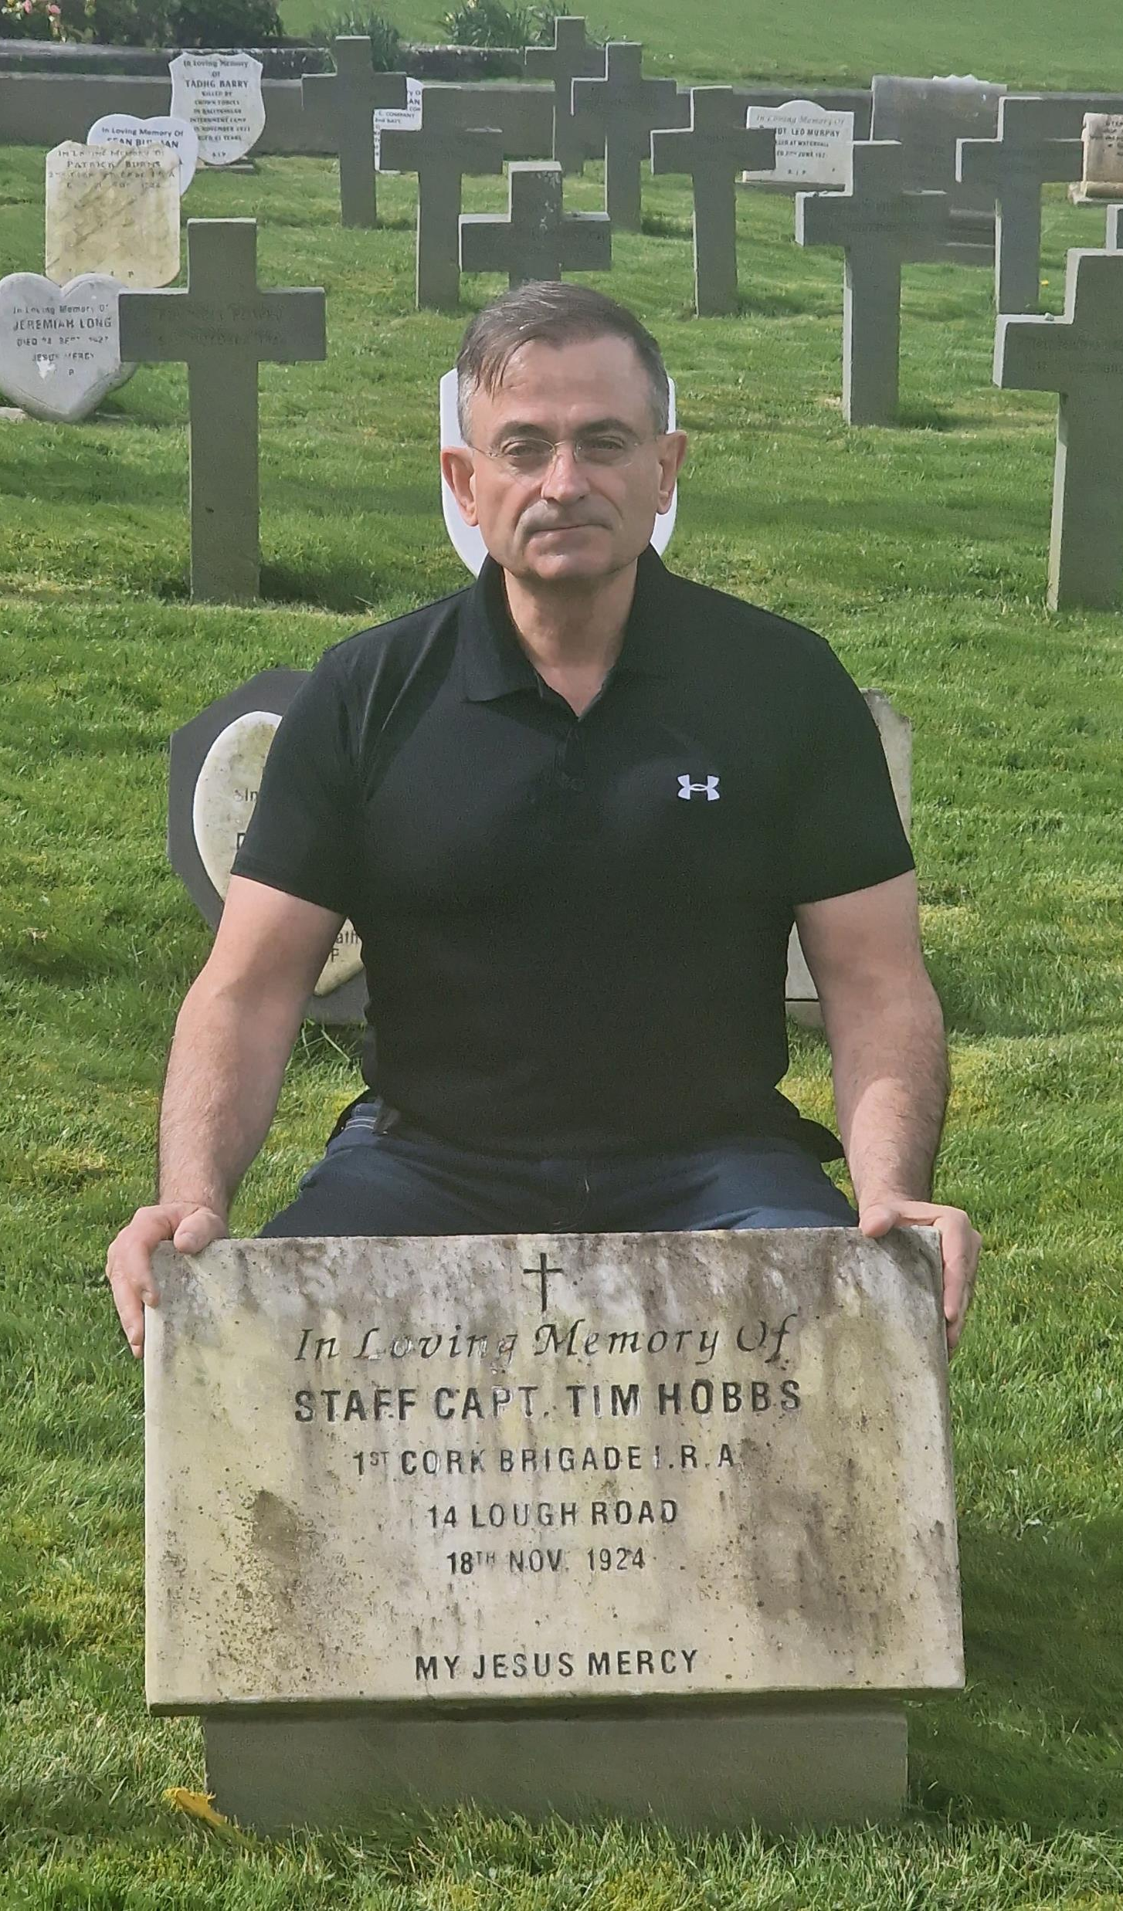
LOUISIANA KICKS OFF THE RESISTENCE

Slide 44
Books, Websites, Who to Follow
1215Tribes.com new resources website
The Psychology of Mass Formation by Mattias Desmet PhD University of Ghent
The Real Anthony Fauci by Robert F Kennedy Jr.
The Wuhan Cover Up by Robert F Kennedy Jr
Climate Uncertainty & Risk Rethinking Our Response by Judith Curry Climatologist
The Great Taking by David Webb
Rockefeller; Controlling the Game by Jacob Nordangård Ph.D
https://worldcouncilforhealth.org/.
https://childrenshealthdefense.ie/.
@P_McCulloughMD @robinmonotti @fatemperor @petersweden7@TraceyOMahony81 @cartlandDavid @drAseemMalhotra @Abridgen @kevinnbass @stkirsch @desmetMattias @JamesMelville @james_freeman @kevin_Mckernan @lawrie_dr @KLVeritas @curryja @RobertKennedyJr @NassMeryl @shabnamPalesaMo @GurkUna @MikeBenzCyber @frankgaffney @ConceptualJames @iamLisalogan

Slide 45
1215 Symbol of Defiance
Explain Symbol to Buddies
For Freedom
Against Globalist Tyranny
Put on your Profiles
Display on Social Media
Whatsapp, Telegram, Signal
Add to Contact Card

Slide 46
What Can I do?
Fight, but be Proactive; the WHO arrives in May 2024
Go to 1215Tribes.com for Resources
Start your own campaign to demand a Referendum on the WHO Treaty, our legacy from Crotty 1987
Blitz your network, WhatsApp, Telegram, Signal. Do Tiktok clips to add to the chorus. Adopt 1215 Symbol
Use public email database to alert and educate local politicians in the dark about what is about to go down
Email the Cabinet, remind Ministers that they are the Guardians not the Disposers of the Constitution insist on min 4 month delay Article 52 (2) IHR
Form small action groups to help each other out and brainstorm
Start now at Local & European Elections, ask Hard Questions
Signal reprimand to legacy media by exiting sites and feeds, depleting their eyeballs data
THE TRUTH IS LIKE A LION. YOU DON’T HAVE TO DEFEND IT. LET IT LOOSE. IT WILL DEFEND ITSELF. (att. St Augustine)

